Slide 1
How to communicate feelings + ideas
YOUTH GROUP RESOURCE

Slide 2

What are Feelings and what are Ideas?

Slide 3
Feelings
"To feel intensely is not a symptom of weakness, it is the trademark of the truly alive and compassionate

Slide 4
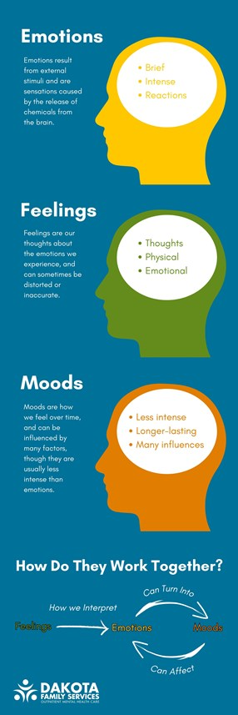
Emotions, which originate as sensations in the body, are intense feelings (exhilaration, terror, despair) that last only seconds to minutes.
Feelings are generated from our thoughts about those emotions. Or in other words, feelings are how we interpret emotions and let them sink in.
A mood is a state of mind or a general feeling that can influence your thoughts, behaviors, and actions. Less intense than emotions and do not necessarily depend on an event or trigger. Moods are influenced by the environment, diet, exercise, physical health, hormones and what you choose to think about.

Slide 5
Ideas
An idea is a mental impression, thought, or understanding that can represent a plan, belief, or concept.
It is the product of mental activity and can range from a fleeting, creative flash to a complex, well-developed notion.
The specific definition varies across fields like psychology, philosophy, and everyday language.
Common usage
In everyday language, an idea often refers to a thought or suggestion about a possible course of action.
A plan: "I have an idea for a fundraising event".
A suggestion: "It might be an idea to call before we leave".
A purpose: "The whole idea of going was so that we could meet her new boyfriend".
A belief or opinion: "He has some strange ideas about education".

Slide 6
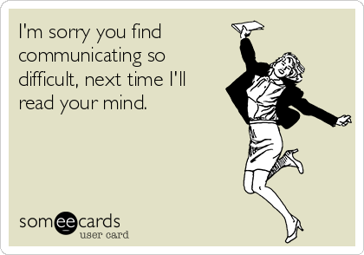
Importance of expressing them

Slide 7
Expressing and communicating your feelings and ideas is crucial for both personal well-being and building healthy relationships with others. It is essential for self-understanding, managing stress, developing meaningful connections, and reaching your full potential.
For personal well-being
Improves self-awareness: By articulating your feelings, you gain a clearer understanding of your own thoughts, values, and motivations.
Promotes emotional health: Holding in or suppressing your emotions can lead to increased stress, anxiety, and depression.
Aids in problem-solving and decision-making: When you can clearly articulate your ideas, you can analyze them, identify weaknesses, and find better solutions.
For interpersonal relationships
Builds trust and intimacy: Openly and honestly communicating your feelings, desires, and fears creates a safe space for vulnerability, which strengthens bonds with friends, family, and romantic partners. Authenticity fosters respect and deeper connections.
Resolves conflicts: Many conflicts stem from unexpressed feelings and misunderstandings.
Fosters empathy and connection: Sharing your experiences with others helps them understand and empathize with you, reinforcing the social ties that are vital to human well-being. In turn, you can better understand their perspectives, which leads to stronger and more satisfying relationships.
Encourages collaboration and innovation: In a team or group, expressing your ideas ensures a variety of perspectives are considered, leading to more informed and well-rounded decisions. An environment where everyone feels comfortable sharing contributes to greater creativity.
For societal progress
Drives positive change: Expressing ideas, especially those that challenge the status quo, is a catalyst for social movements and progress. It allows individuals to influence public opinion, raise awareness about important issues, and work toward a common goal.
Nurtures creativity and innovation: By giving voice to imagination and unique viewpoints, individuals contribute to the diverse fabric of creativity that drives societal progress. When people are free to express themselves, they spark innovation and push boundaries.

Slide 8
https://www.youtube.com/watch?v=FN2RM-CHkuI&t=106s
VIDEO TIME

Slide 9
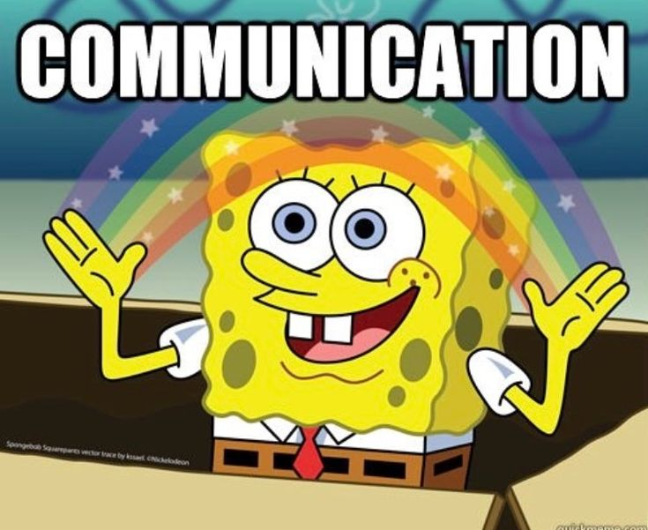
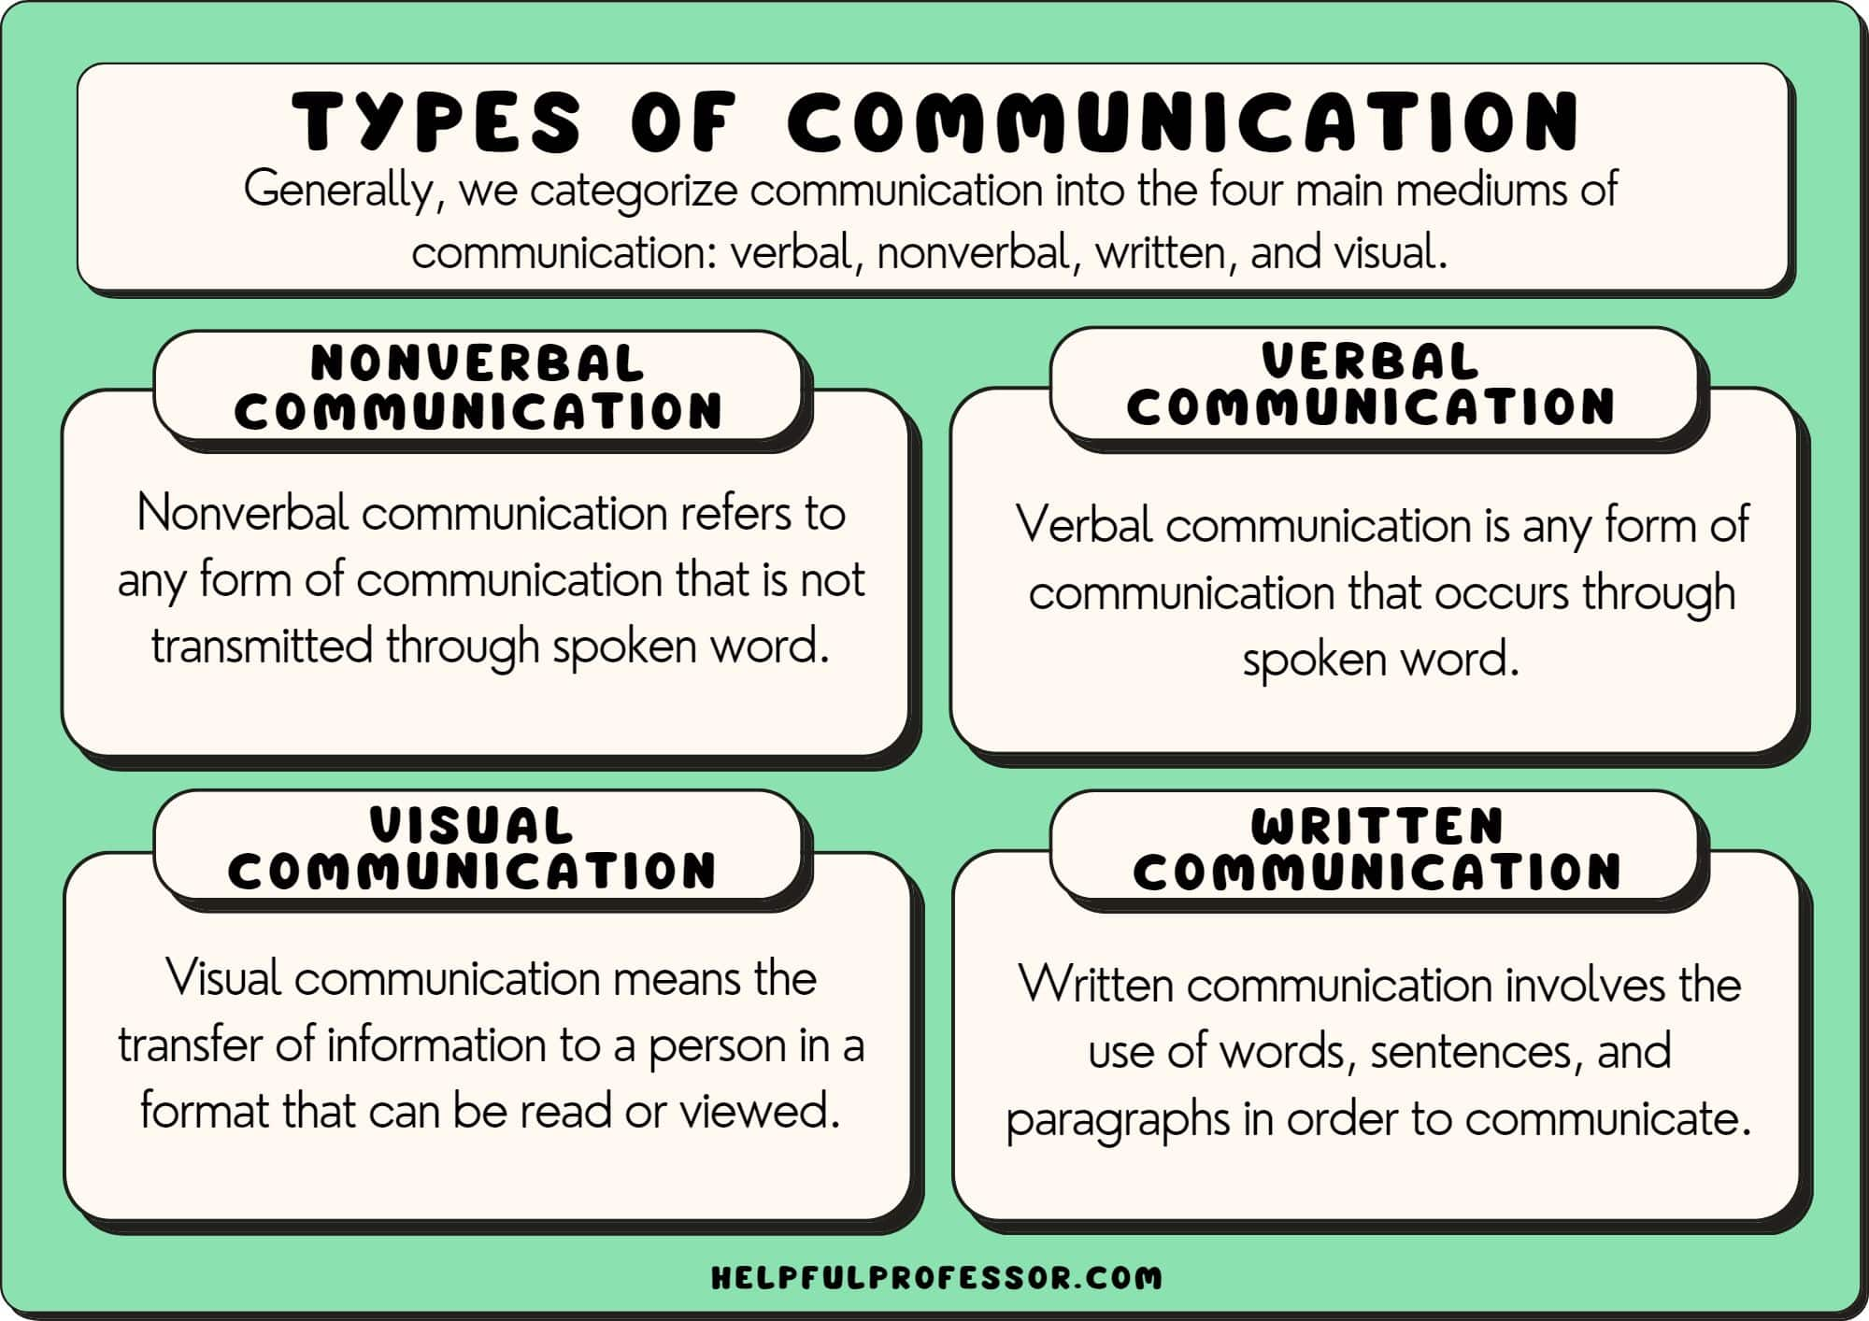

Slide 10
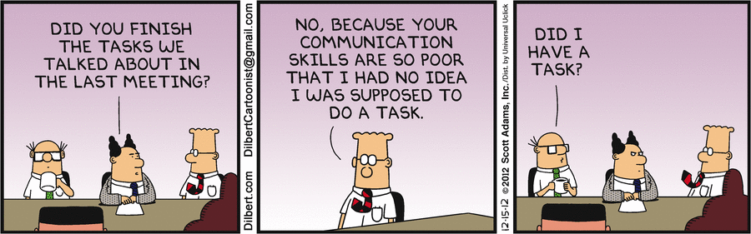
Barriers to communication
Things that prevent effective communication

Slide 11
Barriers
General
Christian Living
Poor listening: Instead of actively listening to understand, people may be formulating their response or be distracted by a personal agenda.
Emotional barriers: Stress, anxiety, or personal biases can filter how a message is received and interpreted.
Physical and technical barriers: Noise, physical distance, poor internet connection, or other technical glitches can obstruct the flow of information.
Information overload: Bombarding someone with too much information at once can overwhelm them and cause them to tune out.
Lack of clarity: Ambiguous language, jargon, or vague instructions can lead to misinterpretation.
Misinterpretation of nonverbal cues: Different cultures and individuals interpret body language, gestures, and tone differently.
Cultural differences: Varying cultural norms and values can impact communication styles and lead to misunderstandings.
Theological jargon
Triangulation and gossip: When people feel uncomfortable addressing conflicts directly, they may talk about others rather than to them. This creates unhealthy communication networks through gossip, emails, or social media posts, which can damage relationships and create division.
Busy-ness, Hierarchy and power dynamics : Pastors and ministry leaders often face packed schedules, which can lead to hurried communication and a lack of availability for deeper conversations with congregants. Power dynamic where congregants feel uncomfortable speaking openly or giving honest feedback
Failure to connect message to life
Fear of conflict
Inconsistent communication: Irregular communication schedules, or sending inconsistent messages across different platforms (bulletins, website, social media), can lead to confusion.

Slide 12
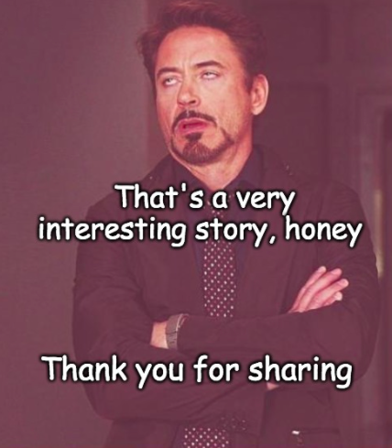

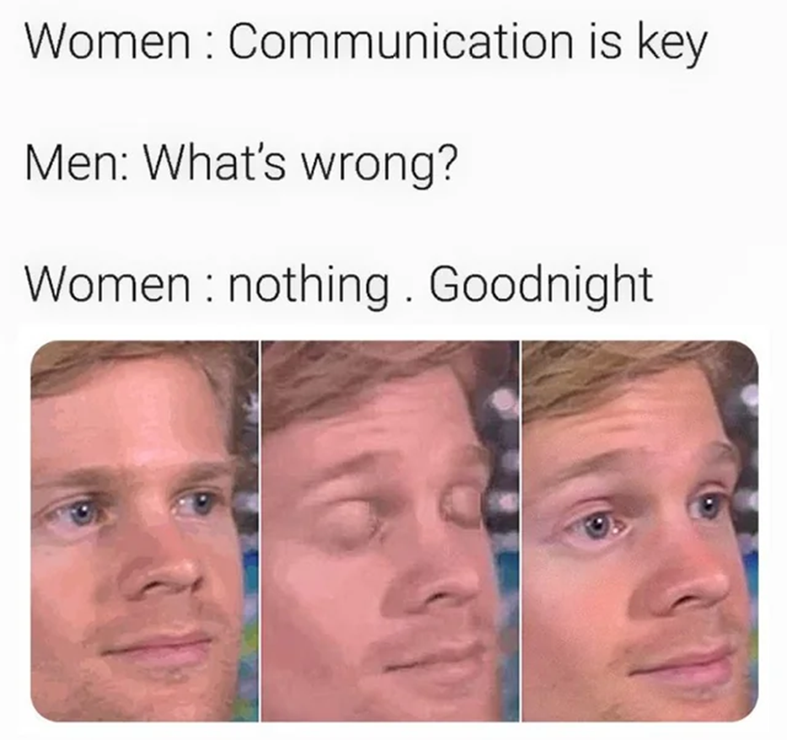
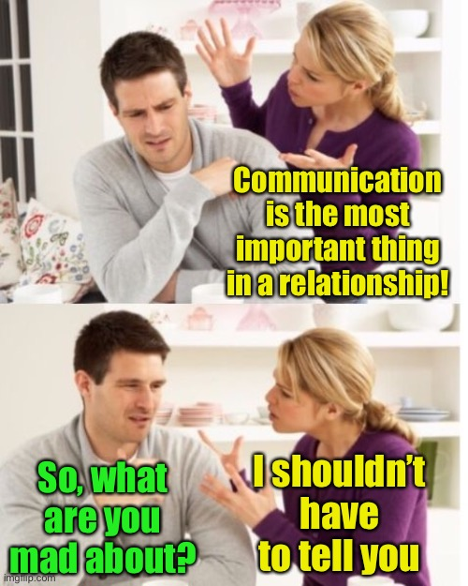
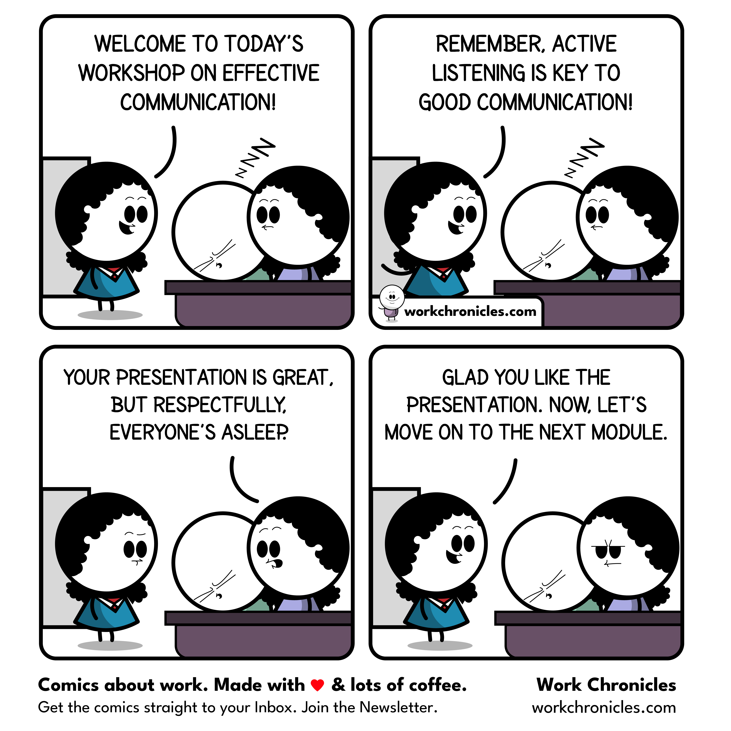


Healthy vs Unhealthy Communications

Slide 13
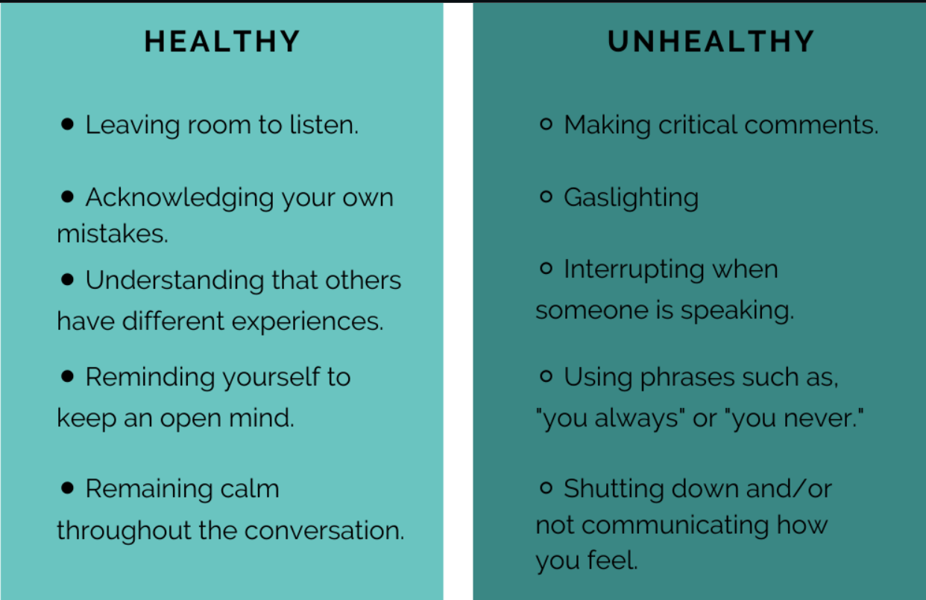

Slide 14
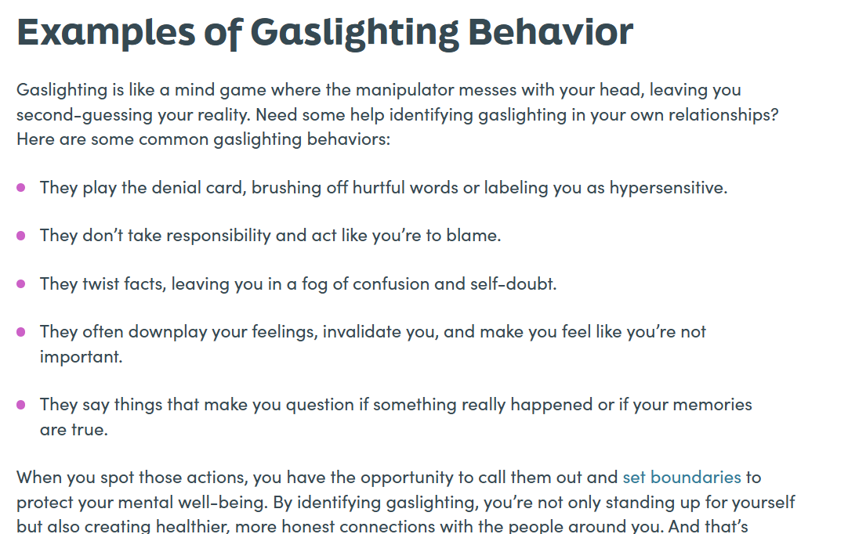

Slide 15
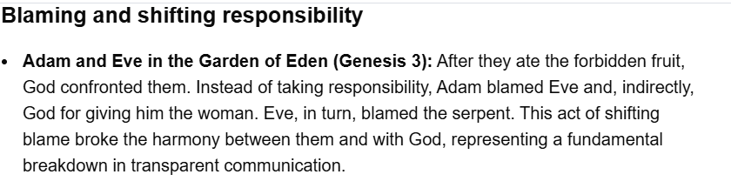
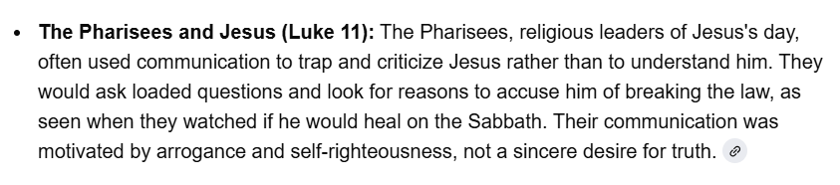
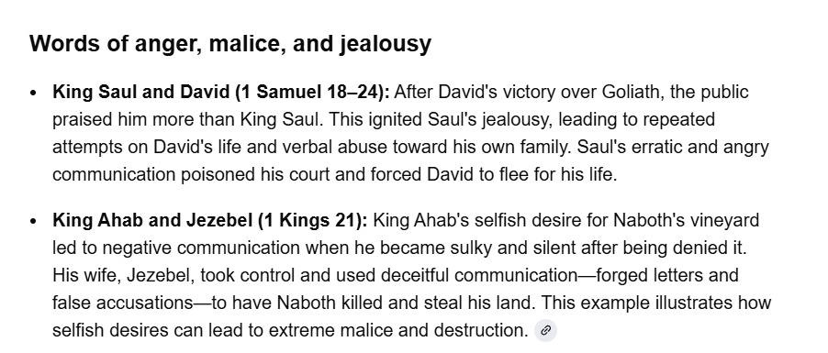

Slide 16
Tools for Healthy Communication
Active listening
Active listening is a foundational skill that requires you to fully focus on the speaker to understand their message and emotions, rather than just hearing the words.
Pay attention: Put away distractions, make eye contact, and observe the speaker's body language.
Show you're listening: Use positive, non-verbal cues, such as nodding, smiling, and having an open posture.
Provide feedback: Paraphrase what you've heard to confirm your understanding. For example, "What I'm hearing is..." or "It sounds like you're saying...".
Defer judgment: Allow the speaker to finish their thoughts completely without interrupting or formulating a rebuttal.
"I" statements
"I" statements are a way to express your feelings and needs directly without sounding accusatory or placing blame on the other person.
The formula: I feel [emotion] when [situation] because [reason]. For example, "I feel frustrated when the report is late because it affects the team's progress".
Assertiveness
Assertive communication allows you to express your needs and set boundaries respectfully. It is the midpoint between passive communication (being timid) and aggressive communication (being hostile).
Be clear and direct: State your point of view in a way that respects others.
Respect others' rights: You advocate for your own needs while still acknowledging and listening to the other person's perspective.
Say no: It's important to know your limits. You can decline a request clearly and concisely without an elaborate explanation.

Slide 17
Tools for Healthy Communication
Constructive feedback
When addressing problems, constructive feedback focuses on specific actions and behaviors rather than making personal attacks.
Focus on the action, not the person: For example, say, "This report has important information missing," instead of "You have done a bad job again".
Offer solutions: Feedback is most effective when it includes actionable steps for improvement. For instance, "Let's review the process together to reduce these errors".
Be timely: Address issues promptly.
Emotion regulation
Managing your emotions is key to staying calm and communicating effectively during a heated conversation.
Take a breather: If a discussion becomes too intense, it's okay to take a moment to calm down before continuing.
Regulate your tone: Pay attention to your voice and body language, as they can convey more than your words. Practice speaking in a calm, firm, and respectful tone
Deal with People according to knowledge
Thinking about how things may affect others. Consideration.

Slide 18
Tools for Healthy Communication Biblically
Scripture emphasizes the importance of using words to build others up, such as in Ephesians 4:29 which encourages speech that is "good for building up", and Colossians 4:6 which advises gracious speech "seasoned with salt". Proverbs 16:24 likens gracious words to "sweetness to the soul and health to the body", while 1 Thessalonians 5:11 calls for encouraging and building one another up.
The Bible also offers wisdom for handling conflict. Proverbs 15:1 notes that a "soft answer turns away wrath". James 1:19 advises being "quick to hear, slow to speak, slow to anger", and Proverbs 18:13 warns against answering before hearing.
Proverbs 13:16 "Every prudent man dealeth with knowledge: but a fool layeth open his folly".
Prudent: Refers to a person who is thoughtful, and careful.
Dealeth with knowledge: Means that a wise person operates and interacts with others based on what they know and have carefully considered. They act with understanding rather than relying on chance or raw emotion.
Layeth open his folly: In contrast, a fool exposes their ignorance and foolishness by speaking or acting without thinking.

Slide 19
https://www.youtube.com/watch?v=GewEyzFueM8
VIDEO TIME

Slide 20
Jesus as a Communicator
Communication techniques used by Jesus
Parables (storytelling)
Jesus frequently used parables—simple, relatable stories drawn from everyday life—to illustrate profound spiritual truths about the Kingdom of God.
Purpose: The parables allowed his message to be accessible to the common people while being understood at a deeper level by those with "ears to hear," and often concealed the meaning from those with hard hearts.
Examples: The Parable of the Sower, the Prodigal Son, and the Good Samaritan all used familiar concepts like farming, family, and social relations to reveal complex divine truths.
Asking incisive questions
Instead of simply giving answers, Jesus often responded to questions with a question of his own. This technique was used to:
Expose motives: When religious leaders tried to trap him, Jesus's counter-questions exposed their true intentions.
Facilitate self-discovery: By asking questions, Jesus encouraged people to think critically and discover truths for themselves, which is more powerful than being told.
Engage personally: He asked personal questions, such as "What do you want me to do for you?" to engage directly with individuals on their needs and desires.
Adapting his message to different audiences
Jesus's communication style varied depending on who he was addressing, tailoring his message to their background and level of understanding.
Crowds: He taught the masses using broad, simple parables based on common life experiences.
Religious leaders (Pharisees and Sadducees): He engaged in theological debates with them, using their knowledge of the law to challenge their legalistic interpretations.
Disciples: With his inner circle, he provided more detailed explanations of the parables and taught on matters of the heart with deep intimacy.
Individuals: In one-on-one conversations, such as with the Samaritan woman at the well, he spoke directly to the person's specific circumstances and needs.
Using visual aids and lived experience
Jesus utilized object lessons and created experiences to bring his messages to life, making them more memorable and impactful.
Examples: He spoke of lilies and sparrows to illustrate God's provision and used a child to demonstrate the nature of childlike faith. He also taught lessons through his actions, such as washing his disciples' feet to model servant leadership.
Communicating with authority and empathy
People were amazed by Jesus's authority in his teaching, as he spoke directly from his own knowledge rather than quoting other teachers. This authority was balanced with genuine compassion and empathy, which he demonstrated through listening carefully and engaging with the personal needs of those he met.
Strategic silence
In moments of intense opposition, Jesus sometimes chose to remain silent, which often had a more powerful effect than words. For example, his silence before Pilate's accusers underscored his sovereign control over the situation and prevented his words from being used against him

Slide 21
THANK YOU!
Daz it Dey

