Slide 1

How to apply for a job
Youth Group Resources

Slide 2


Agenda
Why do we need a job?
Where do we look?
How do we choose?
What is a job application?
What is a resume?
What is a CV?
What is a Cover letter?
How do we wait/follow-up?
How to ace an interview?
How to act when we get the job?
The Reality of Job hunting

Slide 3


Why do we need a job?

Slide 4
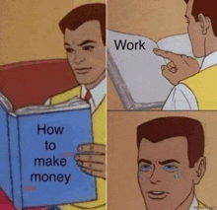
Obviously Money

Slide 5
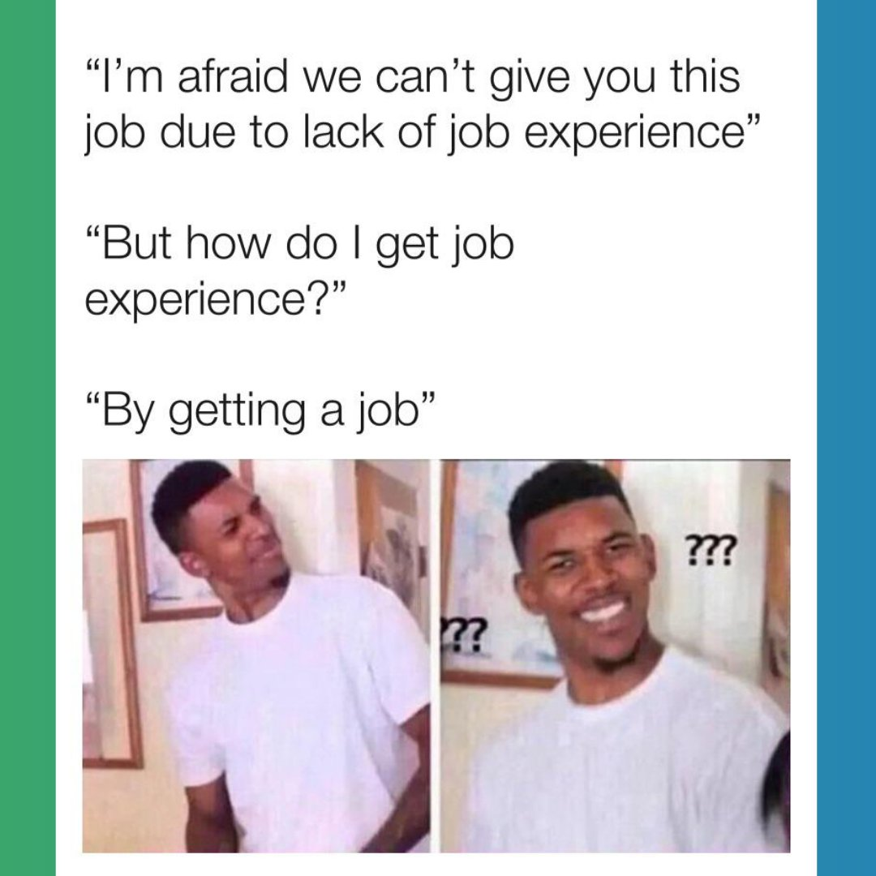
Experience

Slide 6
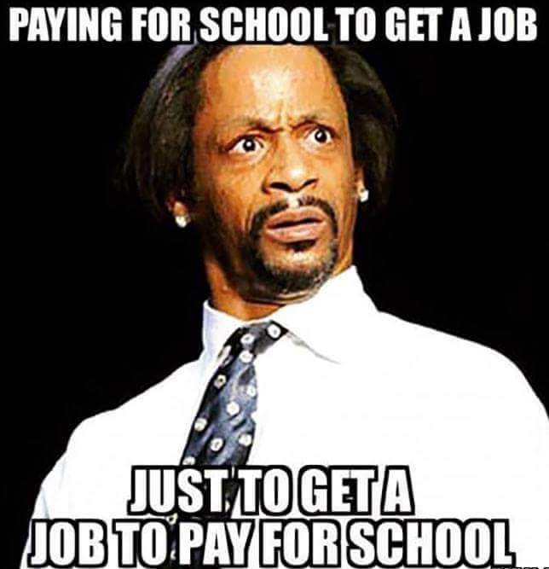
Financial Opportunities
Loans
Credit cards
Investments
Pension plans
Health plans etc.

Slide 7

Personal Growth

Slide 8
What God says
1 Timothy 5:8
8 Anyone who does not provide for their relatives, and especially for their own household, has denied the faith and is worse than an unbeliever
Ephesians 4:28
28 Anyone who has been stealing must steal no longer, but must work, doing something useful with their own hands, that they may have something to share with those in need.

Slide 9

Where do we look?
​

Slide 10
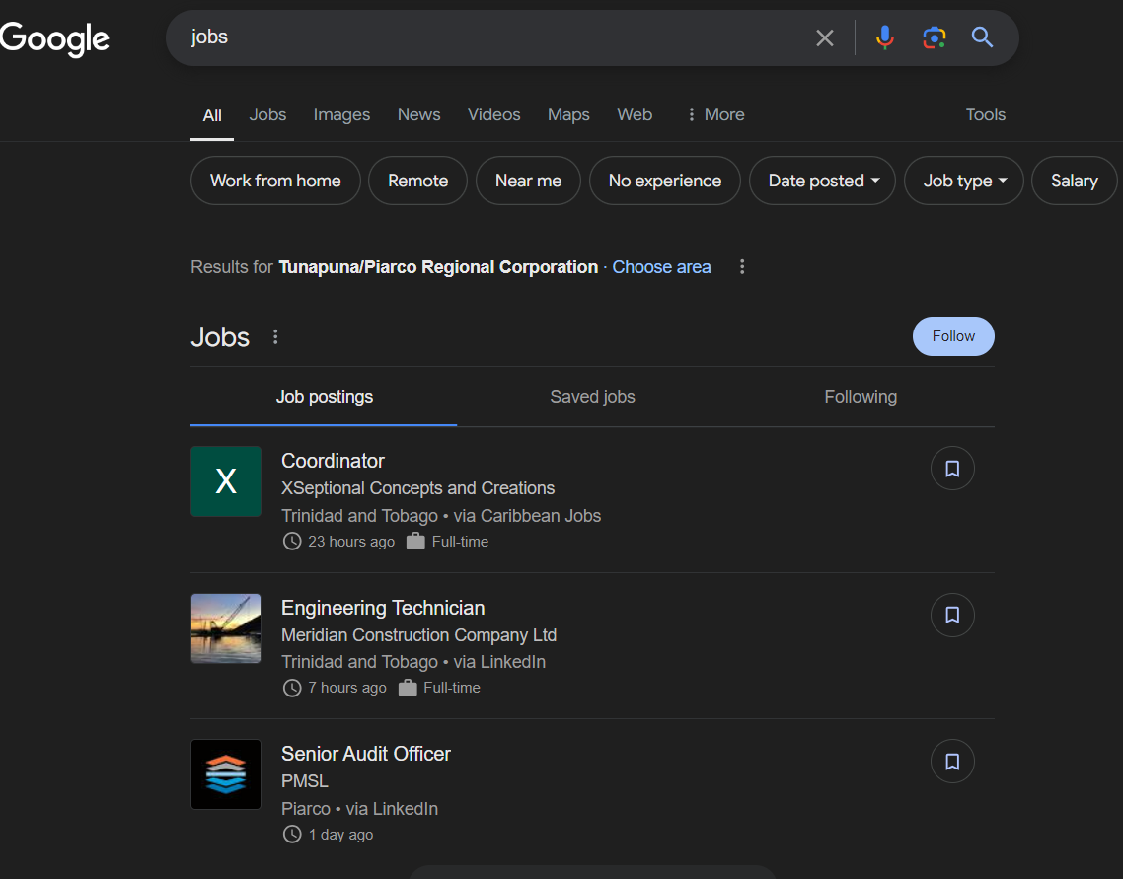
Where do we look?
Steps:
Google TT
Search bar
Type Jobs
​

Slide 11
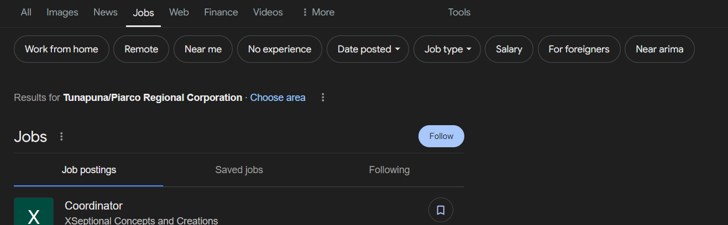
Where do we look?
​

Slide 12
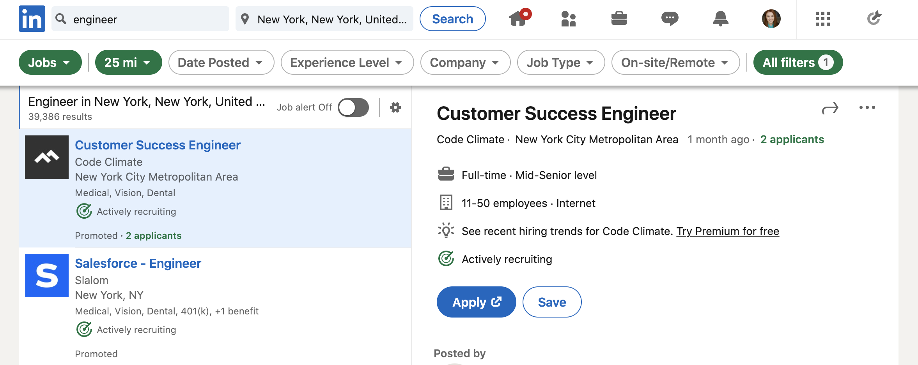
Where do we look?
LinkedIn
​

Slide 13
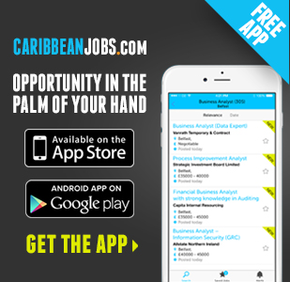
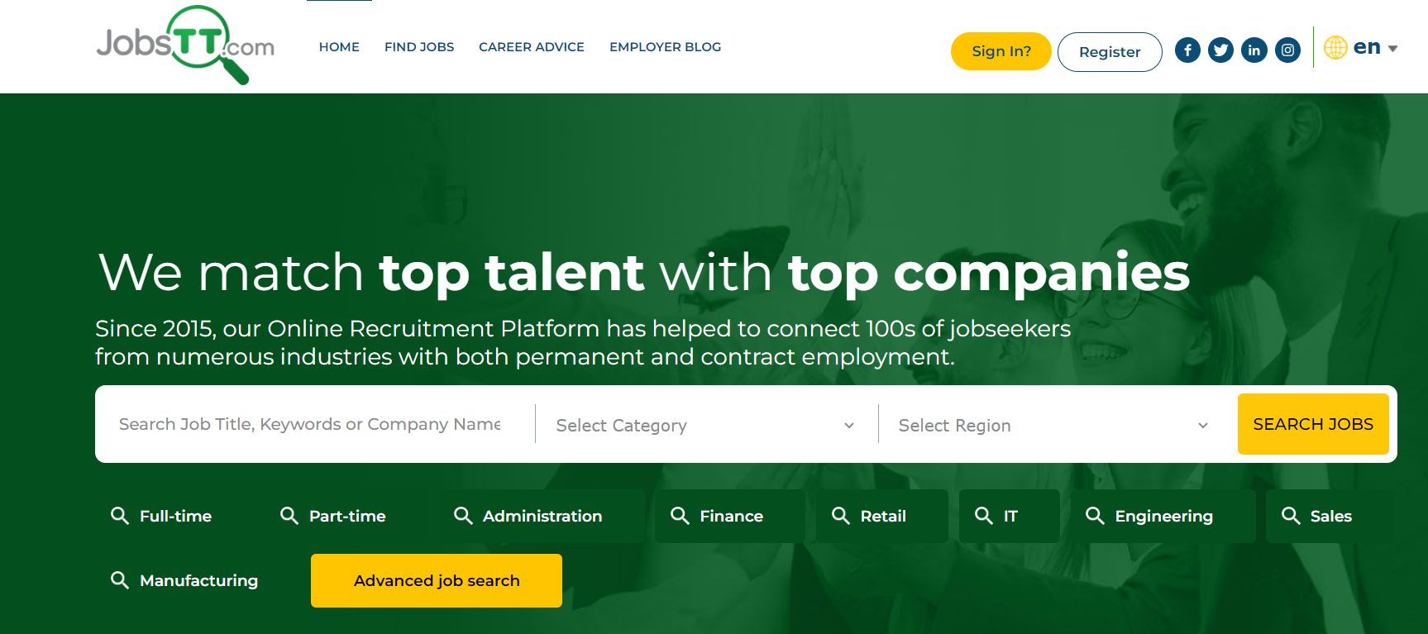
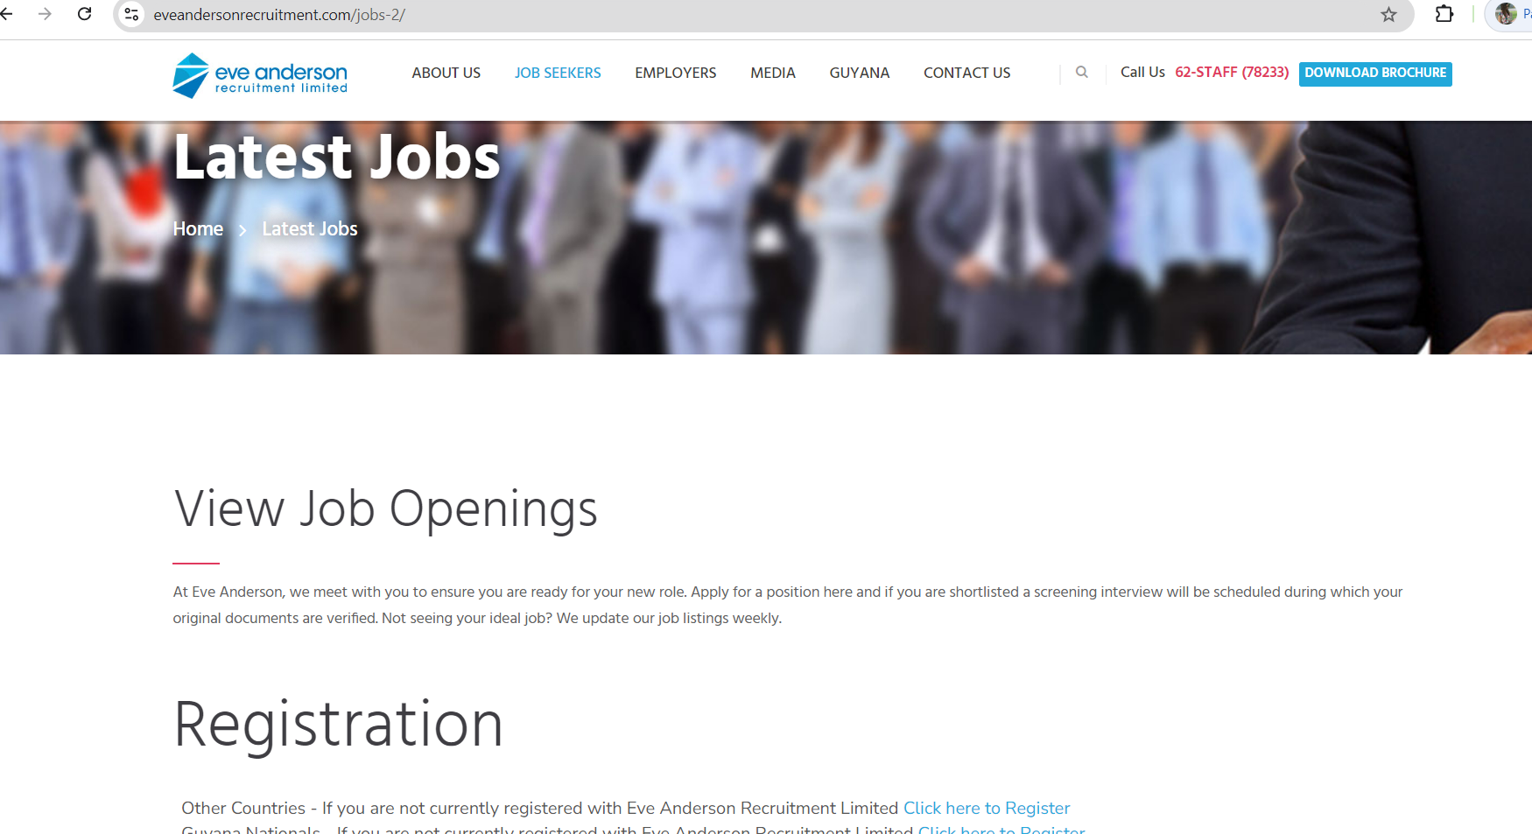
Where do we look?
Job Sites
​

Slide 14

Where do we look?
STAY AWAY!!!!!
​
Shady Facebook groups
Shady websites
Posts where not enough info is given/ shady locations are given

Slide 15

How do we choose a job?​
What you’re qualified to do
What your skill set is
What you like
Location of job (especially if you travel)
Salary expectations
Work hours
PRAYER!

Slide 16

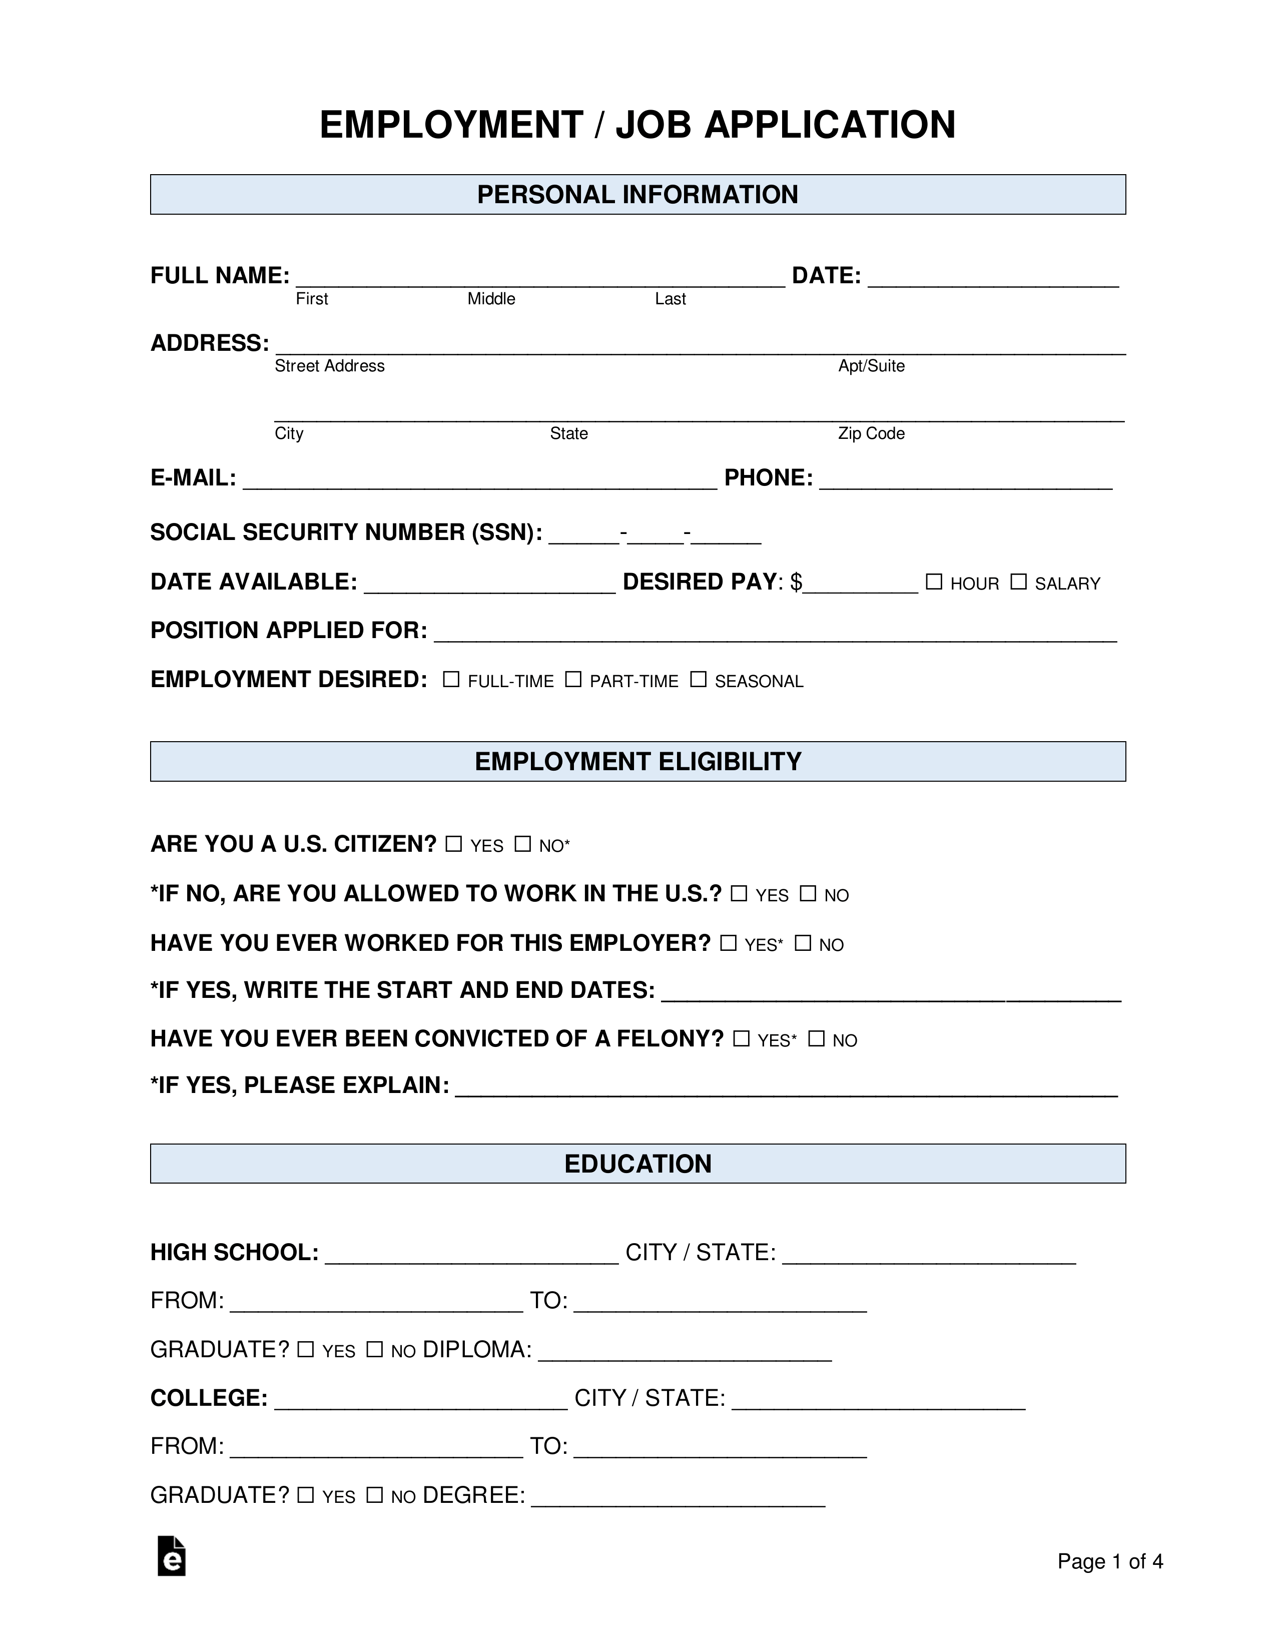
What is a job application?
Job Application Form​​
A job application form is an official document given to candidates by the employer that are used for assessment of the position along with resume/cv, copies of certificates, work samples and references.
Forms are legally defensible and can be digital or hardcopy, and they gather candidates' personal information, career history, capabilities, salary expectations, availability, references.

Slide 17
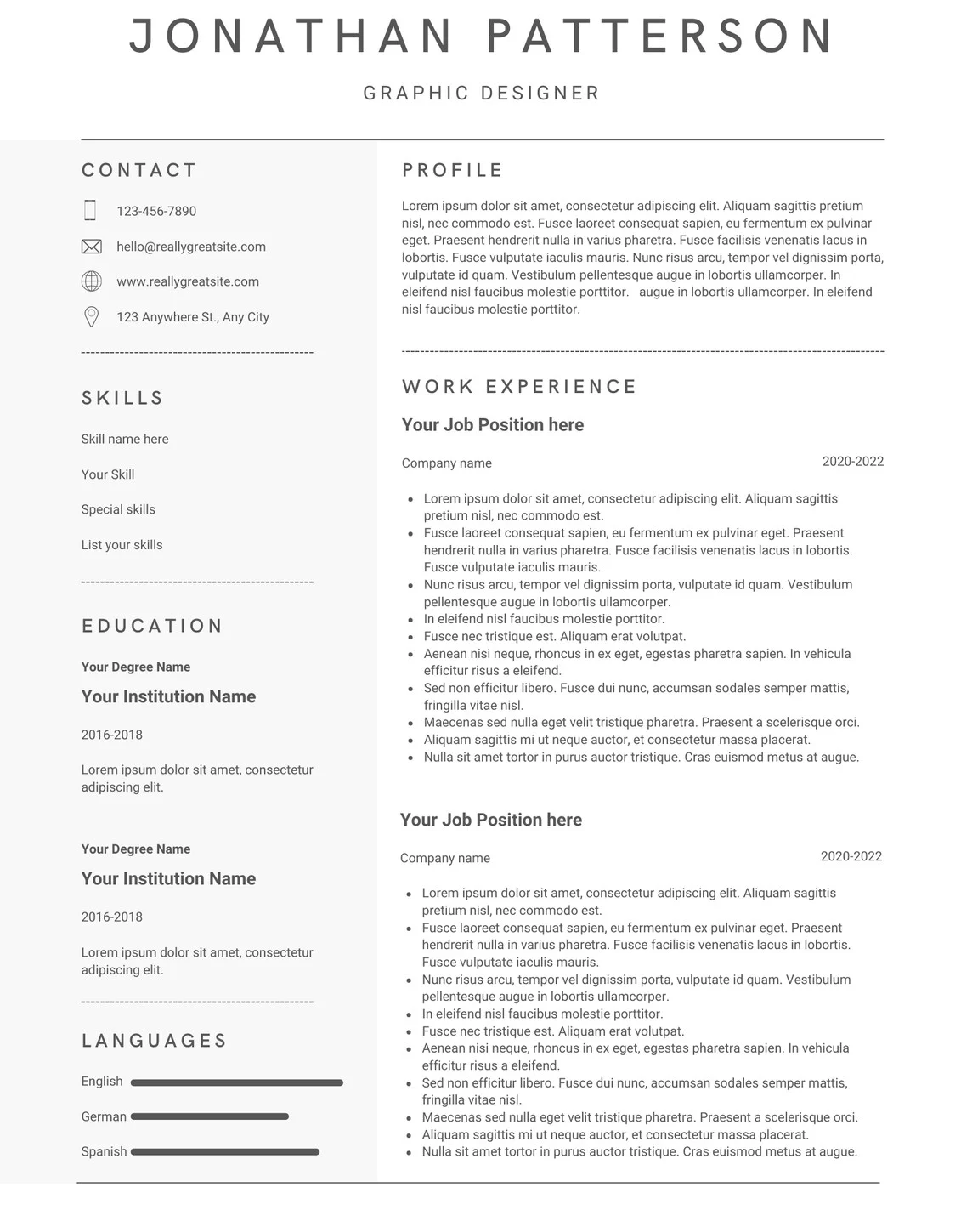
What is a resume?
Resumes include a brief summary (about you), education, experience (in reverse chronological order) and soft skills. Usually, 1-2 pages long.
A final section might be added to highlight specific abilities, such as fluency in a foreign language, knowledge of computer languages, professionally useful hobbies, professional affiliations, and any honors achieved.
A clean layout, and clear language are prized. Recruiters sort through hundreds of resumes and have short attention spans.
.

Slide 18
What is a resume?
Start of your resume should have your name, email address, phone number, address on LinkedIn, the address of your website or blog if you have one.
Hiring managers will, enter your name in the Google search field and find social media etc.
Your About Me/Profile should include:
A strong opening sentence highlighting core strengths (I am a diploma-qualified receptionist with 5 years of experience in a finance setting, with strong office-administration and client-service skills)
Relevant soft skills and achievements tailored to the position (Quickbooks)
Specific results to demonstrate skills (years of service)
Career goals
Keep it one paragraph. Use strong action verbs (leading, achieving, strategizing). Don’t lie or exaggerate.

Slide 19
What is a resume?
Recruiters examine job histories on your resume for significant employment gaps or a pattern of job-hopping. Be prepared to explain either.
Include your CSEC and CAPE Grades. GPA grades and Master Grades are not necessary.
Resume mistakes to avoid:
Typos, grammatical errors (Proofread!)
Being too detailed or too short and unspecific
Impertinent information
Lack of information on skills.
If you do not have any professional work experience, include volunteer work with responsibilities or list any academic organizations you are a part of and any offices and responsibilities you're holding.
You can have multiple resumes geared towards a specific field.

Slide 20
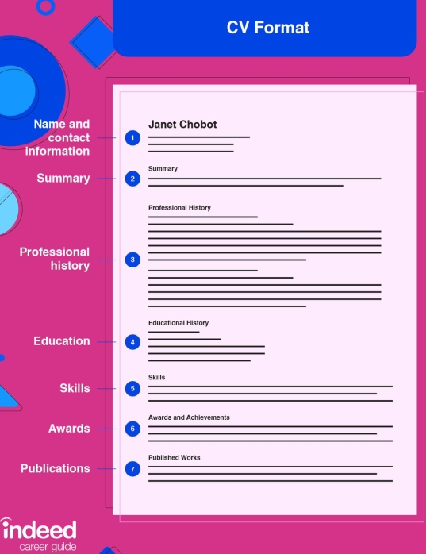
What is a CV?
CV is a longer, more detailed document consisting of personal information relevant to academic and research positions (academic, medical or research type positions).
2-3pages CVs of info like work experience, achievements, awards, scholarships/grants, coursework, research projects and publications of your work.
With a CV, employers are more interested in learning about your professional experience, so it's best to ensure the reader’s focus is on that information.
Professional experience needs to be detailed. For example, instead of writing “Responsible for drafting proposals on muscle cell motility studies,” you might say, “Developed research proposal on structural studies of muscle cell motility in collaboration with a 6-person research team that secured a $20K federal grant.”
.

Slide 21
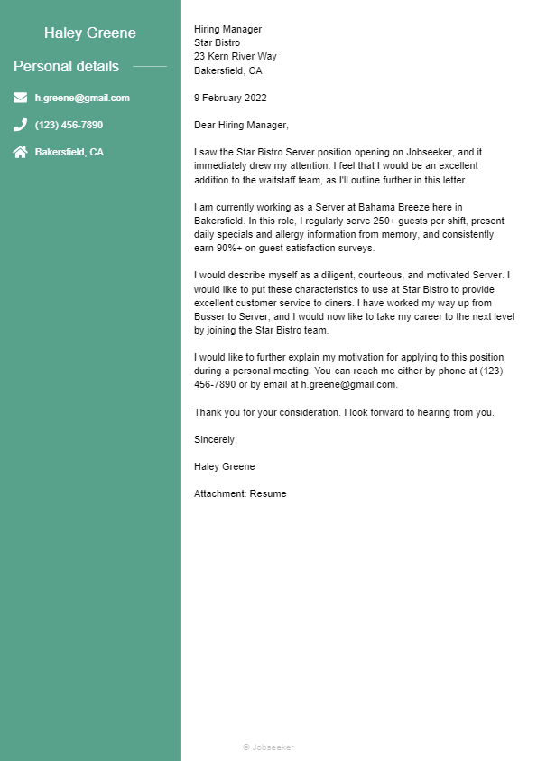
What is a Cover Letter?
A cover letter, 3-4 paragraph memo to employers explaining your interest in the job and company and your fitness for the role. It highlights your skills, experience and achievements concerning the position you seek with more detail about your professional career and explain why you're a good fit for the role and company.
First paragraph, mention the job title you're applying for and where you saw the position posting. Explain your interest in the role and company to show you've done your research
Second paragraph should be a brief overview of your background as it relates to the position. Include key achievements, skills and specialties that make you particularly suited to the position.
Third Paragraph summarize a specific story or anecdote that displays you're right for the role. If you're changing careers, discuss transferable skills or relatable experiences from your career.
.

Slide 22
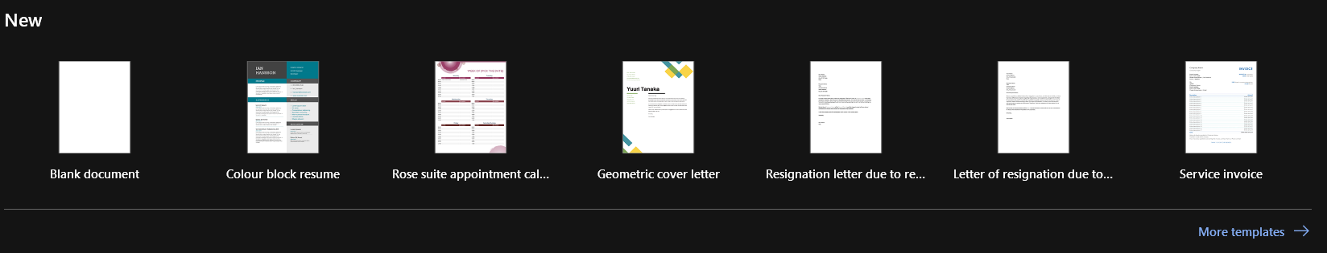
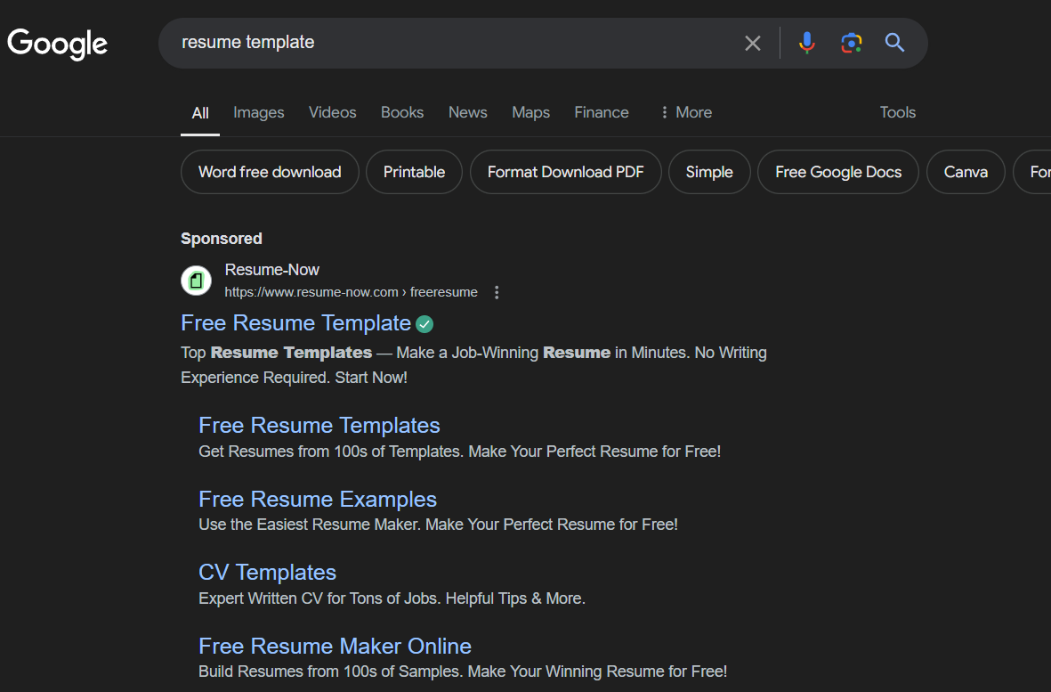


Resume Templates
MICROSOFT WORD
GOOGLE
CANVA/DESIGNING SOFTWARE
.

Slide 23

How do we wait/follow-up?
Psalm 27:13-14 KJV
I had fainted, Unless I had believed to see the goodness of the LORD in the land of the living. Wait on the LORD: Be of good courage, and he shall strengthen thine heart: wait, I say, on the LORD.
Send a follow up email, requesting status of application especially if you received email of confirmation of receipt.
Don’t Spam
PRAYER (Individual & Group)
Lamentations 3:25
“The Lord is good to those who wait for him, to the soul who seeks him.” (ESV)

Slide 24

How to ace an interview?
​
Day(s) Before Interview
​
Dress professionally (suit, shirt and Tie), plan your route to be punctual.
Research the company
Practice Answers to commonly asked questions
​Find out Salary range beforehand so you don’t undershoot or overshoot.
Reread the job description
Be prepared with examples of your work, passport photos, resume, copies of certificates, references, certificate of character and originals.
Phillipians 3:14
I can do all this through him who gives me strength.

Slide 25
How to ace an interview?
​
During Interview
​
When asked about times in the past when you used a specific skill, Use the STAR method—situation, task, action and result.
Tie answers to your skills and accomplishments pertaining to job description
Keep your answers concise and focused
Never talk negatively when asked about past jobs and employers
Respond truthfully
Be yourself

Slide 26
How to ace an interview?
​
After Interview
​
Ask questions on Salary, Work Culture, what a typical day looks like in the position, benefits, amount of vacation days etc.
Ask about next steps, when to expect feedback any additional interviews etc.
Reach out to the company if they have not reached out by the time period they gave.

Slide 27


How to act when we get the job?
Respectful
Punctual
Hard workers
Grateful
No bad-talking former workplaces or comparison making in public
No gossiping
Obey Rules
Do the right thing!

Slide 28
How God says to act when we get the job.
Proverbs 12:24 - Diligent hands will rule, but laziness ends in forced labor.
Proverbs 16:3 - Commit your work to the LORD, and he will establish your plans.
Galatians 6:4-5 - Each one should test their own actions. Then they can take pride in themselves alone, without comparing themselves to someone else, for each one should carry their own load.
Colossians 3:23 - Whatever you do, work at it with all your heart, as working for the Lord, not for human masters,
Titus 2:7-8 - In everything set them an example by doing what is good. In your teaching show integrity, seriousness and soundness of speech that cannot be condemned, so that those who oppose you may be ashamed because they have nothing bad to say about us.
1 Thessalonians 5:16-18 Rejoice always, pray continually, give thanks in all circumstances; for this is God’s will for you in Christ Jesus.

Slide 29
The Reality of Job Hunting
You will send out many applications and may only get a few calls and out of those calls a few interviews.​
You will hear about or even try looking for ‘links’​

Slide 30
The Reality of Job Hunting
Your references can make or break hiring personnel decisions which is why we don’t burn bridges. ​
It can be depressing, demotivating and worrying.

Slide 31

​
Matthew 6:33
But seek first the kingdom of God and his righteousness, and all these things will be added to you.

Slide 32

All the Best on Job Hunting!
May you choose the one God wants for you.
​

