Slide 1

“Answering the Call”
Youth Group Resources
Introducing Ministries in the Local Church

Slide 2



1 Samuel 3:7-10
Therefore, Samuel did not yet know the Lord, nor was the word of the Lord yet revealed to him.) And the Lord called Samuel again the third time. Therefore, he arose and went to Eli, and said, “Here I am, for you did call me.” Then Eli perceived that the Lord had called the boy. Therefore, Eli said to Samuel, “Go, lie down; and it shall be, if He calls you, that you must say, ‘Speak, Lord, for Your servant hears.’” So, Samuel went and lay down in his place. Now the Lord came and stood and called as at other times, “Samuel! Samuel!” And Samuel answered, “Speak, for Your servant hears.”

Slide 3




Local Church positions
Pastor’s Council (according to 2018 COG Minutes)
Church Treasurer (according to 2018 COG Minutes)
Church Clerk
Deacon
Facilities Manager
Church Cleaning

Slide 4

Local Church Department
Women’s Department

Slide 5
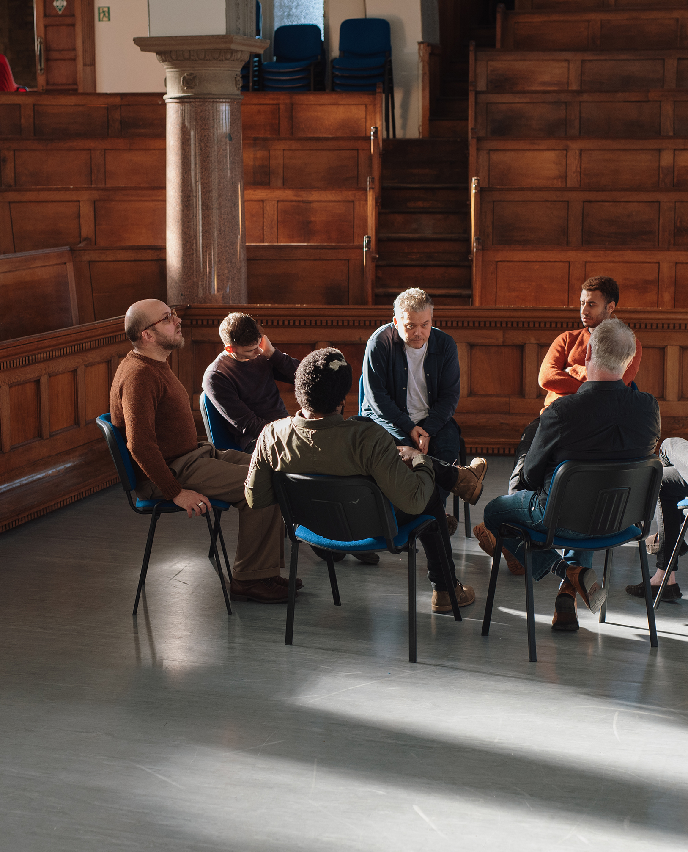
Local Church Department
Men’s Department

Slide 6

Local Church Department
Evangelism Department

Slide 7

Local Church Department
Discipleship Program

Slide 8

Local Church Department
Youth Department

Slide 9

Local Church Department
Ushers Department

Slide 10

Local Church Department
Goods Basket

Slide 11

Local Church Department
Worship Department

Slide 12

Local Church Department
Tech Department

Slide 13

⁹ “As for you, my son Solomon, know the God of your father, and serve Him with a loyal heart and with a willing mind; for the Lord searches all hearts and understands all the intent of the thoughts. If you seek Him, He will be found by you; but if you forsake Him, He will cast you off forever. ¹⁰ Consider now, for the Lord has chosen you to build a house for the sanctuary; be strong, and do it.”
1 Chronicles 28:9-10

Slide 14




Youth Testimonies and Comments

Slide 15

Thank you all!

