Slide 1

How to Navigate
Social Media
// YOUTH GROUP RESOURCE
FICTION
vs
REALITY

Slide 2
// Let’s educate ourselves.
THE TRUTH OF SOCIAL MEDIA
https://www.youtube.com/watch?v=4maJty0vQjI
Addictions
Weaponized Hope
Triggering Content – Even False Content
Doomscrolling
Money runs it… not truth…not peace…not even your benefit/wellbeing

Slide 3
Feed Is Intentional
// START HERE
What shows up on your feed is chosen for you. Engineered to keep your attention. To keep the truth from you.
01
02
03
CURATED
ALGORITHMIC
MONETIZED
Individuals post the best of their life. Most times edited and filtered. They post what they want others see.
Based on your likes, watch time, shares and how long you pause on a post, content is suggested and prioritized to hold your attention on the feed. It learns and adjusts your content
Your attention is the product being sold. More views, more money.
James 3:14-16 But if you have bitter envy and self-seeking in your hearts, do not boast and lie against the truth. This wisdom does not descend from above, but is earthly, sensual, demonic. For where envy and self-seeking exist, confusion and every evil thing are there

Slide 4
Fiction vs Reality
// THE CORE TENSION
THE FICTION
THE REALITY
Perfect bodies, perfect lives
Filters and Edits
Staged Moments
Scenes were there are no consequences
AI images of impossible/unnatural things
Fake news
“Everyone's doing better than me”
Rich lifestyles are hard to maintain
Highlight reels hide the hard days
Rejection
People hardly post pain
Real life is unfiltered, unedited and doing stupid things will result in consequences
The truth can destroy comfortable lies so it’s hidden
“Everyone is not doing better than you.”

Slide 5
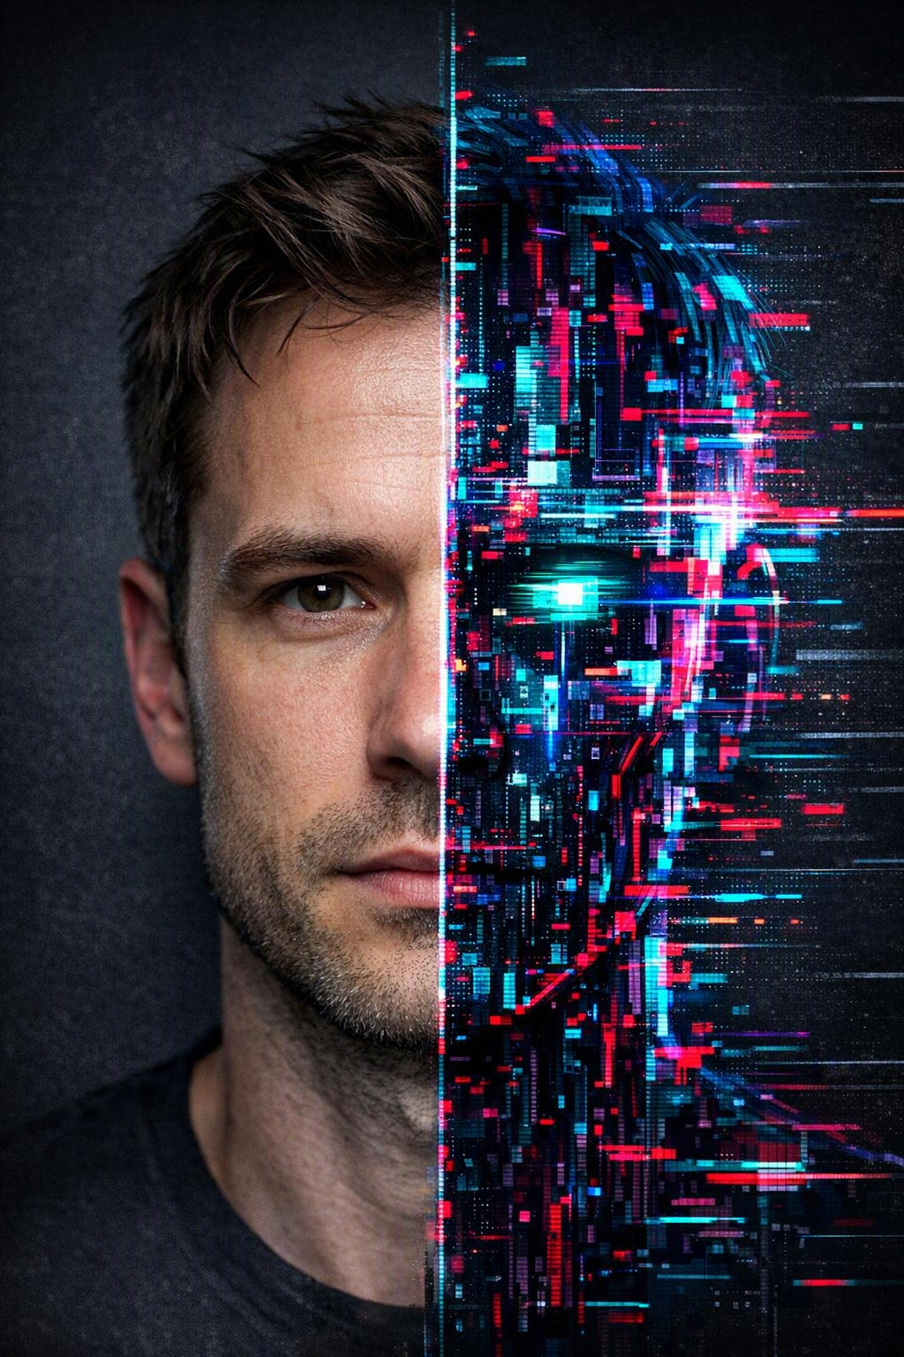
Real or AI?
// SKILL 01
AI video and deepfakes are getting good — but they still leave clues.
1
Watch hands, ears & teeth
AI often warps fingers, jewelry and tiny details.
2
Check the blink & lip-sync
Odd blinking or lips out of sync are red flags.
3
Look for glitchy edges
Flickering hair, melting backgrounds, warped text.
4
Trace the source
Who posted first — a real account or a brand-new page?

Slide 6
Real or AI?
// SKILL 01
AI video and deepfakes are getting good — but they still leave clues.
5
Texture & Pattern Repetition
AI doesn’t do complex textures and patterns right. It may repeat or have awkward transitions or may use simple patterns altogether
6
Inconsistent Lighting/Shadows
Check if lighting/shadows are consistent to the light source.
7
Contextual Errors
Mismatch of scale, out of place objects for culture, time-period or setting.
8
Emotions aren’t generated correctly
Faces may not match the mood the image conveys

Slide 7
Real or AI?
// SKILL 01
QUIZ TIME!
5
https://britannicaeducation.com/blog/quiz-real-or-ai/
6

Slide 8

Fact-Checking
// SKILL 02
If a post makes you instantly furious or amazed, pause. Strong feelings are how lies spread.
1
Pause before you react
Don't share on emotion. Think.
2
Find the original source/ Ask Google to verify if it’s true
Trace the claim to who said it and when.
3
Cross-check 2–3 trusted sources (News sites, Scholarly articles)
Truth shows up in more than one trusted place.
4
Check the date & context
Old or edited clips get reused to mislead.

Slide 9

Dangers of the Feed
// KNOW THE RISKS
1
Comparison steals joy
Measuring your life against other’s unrealistic lives breeds anxiety, depression and self-condemnation.
2
The endless scroll/AI
Addiction eats your time, your sleep, your creativity, your money
3
Cyberbullying & pressure
Words online cut deep; screenshots/pictures last forever.
4
Strangers & unsafe content
Not everyone is who they claim. Guard your privacy.
“Guard your heart, for everything you do flows from it.” — Proverbs 4:23
“And do not be conformed to this world, but be transformed by the renewing of your mind, that you may prove what is that good and acceptable and perfect will of God."— Romans 12:2

Slide 10

Use Social Media Well
// USE IT WELL
1
Set limits & no-phone zones
Silence notifications; keep meals, social time in presence of friends/family, work and bedtime free.
2
Curate your feed on purpose
Follow what builds you up; mute what drags you down. Some sites you can edit your algorithm.
3
Create more than you consume
Learn, encourage, make — don't just scroll.
4
Connect, then log off. Get physical hobbies.
Reach real people, then go live your real life. Gym. Painting. Sports. Chess. Drives. Music. Church.
“Whatever is true, noble, right, pure, lovely — think about such things.” — Philippians 4:8

Slide 11

Faith in the Feed
// FAITH & THE FEED
1
Post and watch content like Jesus is watching
Because He is. Let your words match your faith.
2
Be a light, not a troll
Bring truth and kindness; don't feed the outrage.
3
Protect your peace & time
Trade some scroll time for prayer, people and rest.
4
Truth over trends
Test what you see against God's Word, not the algorithm.
“Then you will know the truth, and the truth will set you free.” — John 8:32

Slide 12

// IDENTITY · PART 2
Rooted: Your Identity in Christ
CHOSEN
· LOVED ·
WONDERFULLY MADE
When your worth is anchored in God, no comment section can shake it. You don't scroll to find out who you are — you already know Whose you are.
“I praise you, for I am fearfully and wonderfully made.” — Psalm 139:14

Slide 13
Your Challenge This Week
// TAKE IT HOME
1
2
3
4
Unfollow 3 accounts
Fact-check once
One screen-free hour
Post one true, kind thing
that leave you anxious, envious or worse.
before you share anything — make it a habit.
each day for prayer, reading the Bible, encouraging one person.
It points to hope, not hype.
Small, consistent choices will reshape your feed — and your heart.

Slide 14
We are in the world, not of it.
// LIVE IT OUT
Scroll with wisdom. Don’t get engaged with everything.
Share with love. Don’t become part of the problem.
Stay rooted in Christ. Represent Him well. We are ambassadors.
15 "Do not love the world or the things in the world. If anyone loves the world, the love of the Father is not in him. 16 For all that is in the world—the lust of the flesh, the lust of the eyes, and the pride of life—is not of the Father but is of the world. 17 And the world is passing away, and the lust of it; but he who does the will of God abides forever."— 1 John 2:15–17

